Slide 1
BLOCH EQUATION COMPUTATIONAL SIMULATION AND LOW FIELD STRENGTH NMR
Harvard College CHEM 10
Abel Bellows

Slide 2
Content
1
Nuclear Spins
4
Computational Simulation
2
Bloch Equations
5
Physical Demonstration
3
NMR: conceptual model
6
Successes and Failures
Harvard College
CHEM 10
Bellows

Slide 3
Fundamental particles have “Spin.”
Spin can be measured in x,y, and z directions.
The nuclei of atoms also have spin.
Basics of Spin
Company Name
Quarter Month
Year

Slide 4
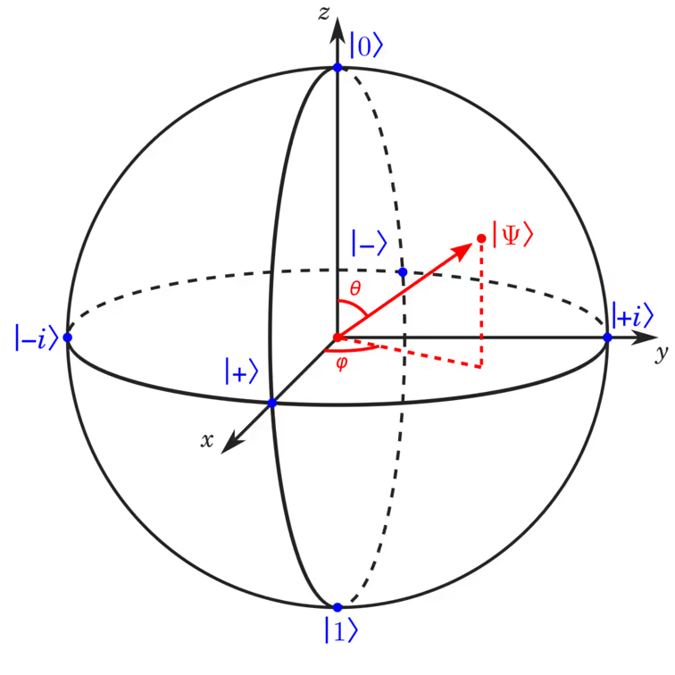
Spin state can be represented as a linear combination of x,y, and z spin wavefunctions.
Represented as vectors with head on a unit sphere.
Bloch Sphere
Bloch Sphere
Bloch Sphere
Harvard College
CHEM 10
Bellows

Slide 5
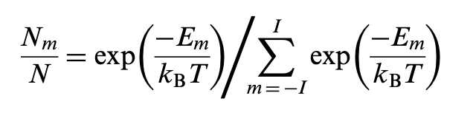
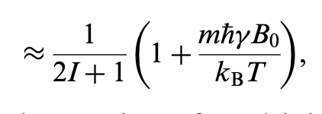
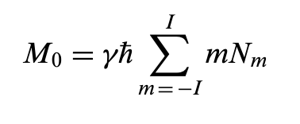
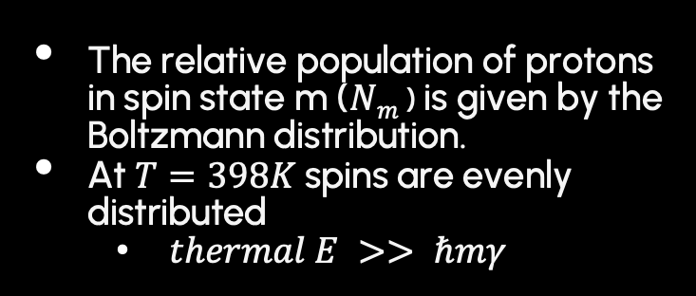
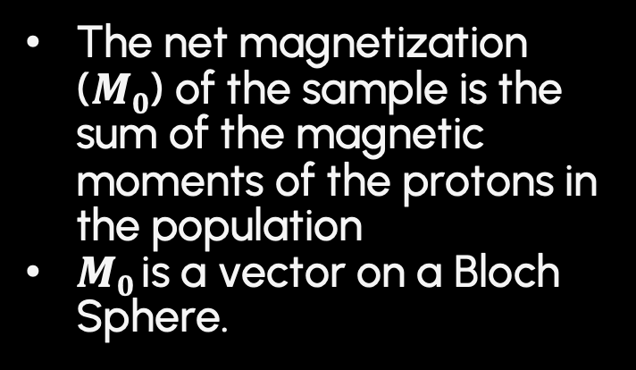
The relative population of protons in spin state m ($Nm$) is given by the Boltzmann distribution.
At $T=398K$spins are evenly distributed
$thermal E >> ℏmγ$
The net magnetization ($M0$) of the sample is the sum of the magnetic moments of the protons in the population
$M0$ is a vector on a Bloch Sphere.
Harvard College
CHEM 10
Bellows

Slide 6
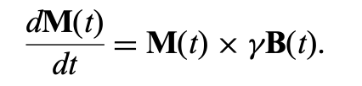
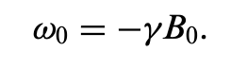

$\frac{dM(t)}{dt}$ in external magnetic field B is given by the torque applied to M(t) by B.
If $B\left(t\right)=B_{0} M$processes with frequency equal to $w_{0}$
Harvard College
CHEM 10
Bellows

Slide 7
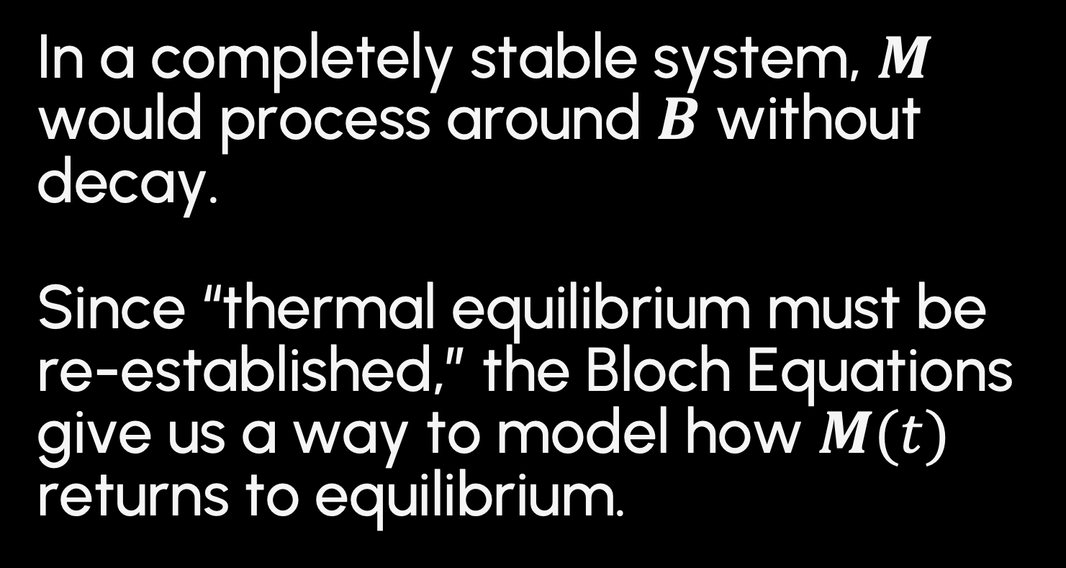
In a completely stable system, $M$ would process around $B$ without decay. Since “thermal equilibrium must be re-established,” the Bloch Equations give us a way to model how $M(t)$ returns to equilibrium.
Harvard College
CHEM 10
Bellows

Slide 8
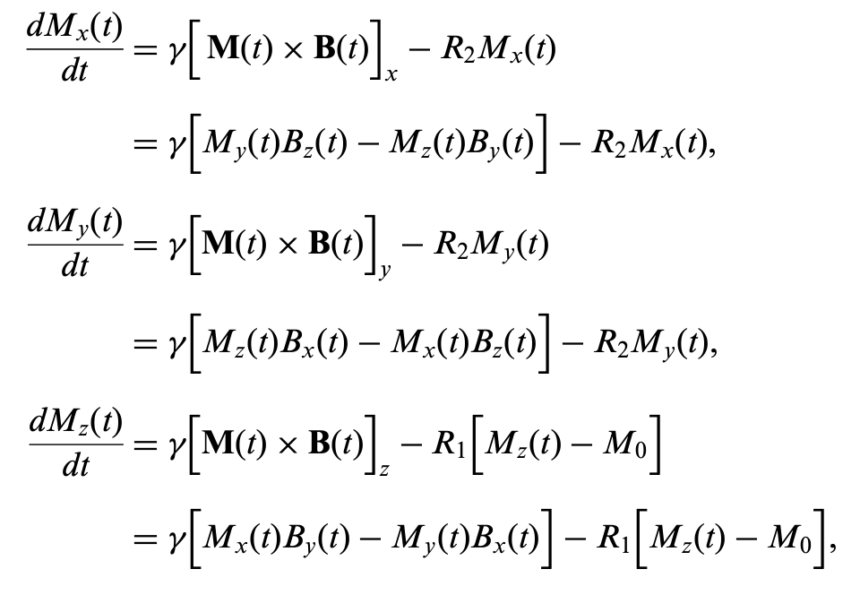
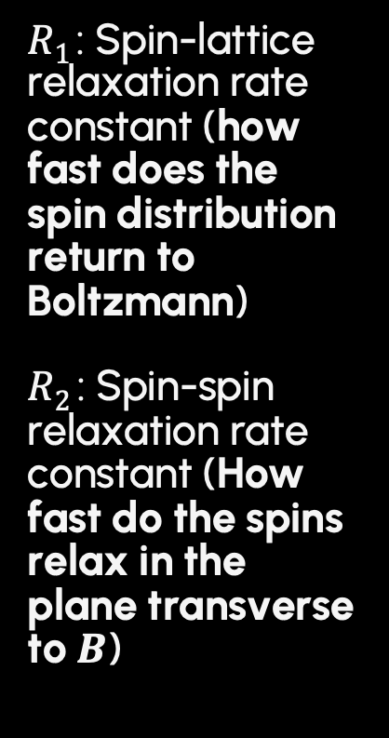
$R1$: Spin-lattice relaxation rate constant (how fast does the spin distribution return to Boltzmann)
$R2$ : Spin-spin relaxation rate constant (How fast do the spins relax in the plane transverse to $B$)
Harvard College
CHEM 10
Bellows

Slide 9
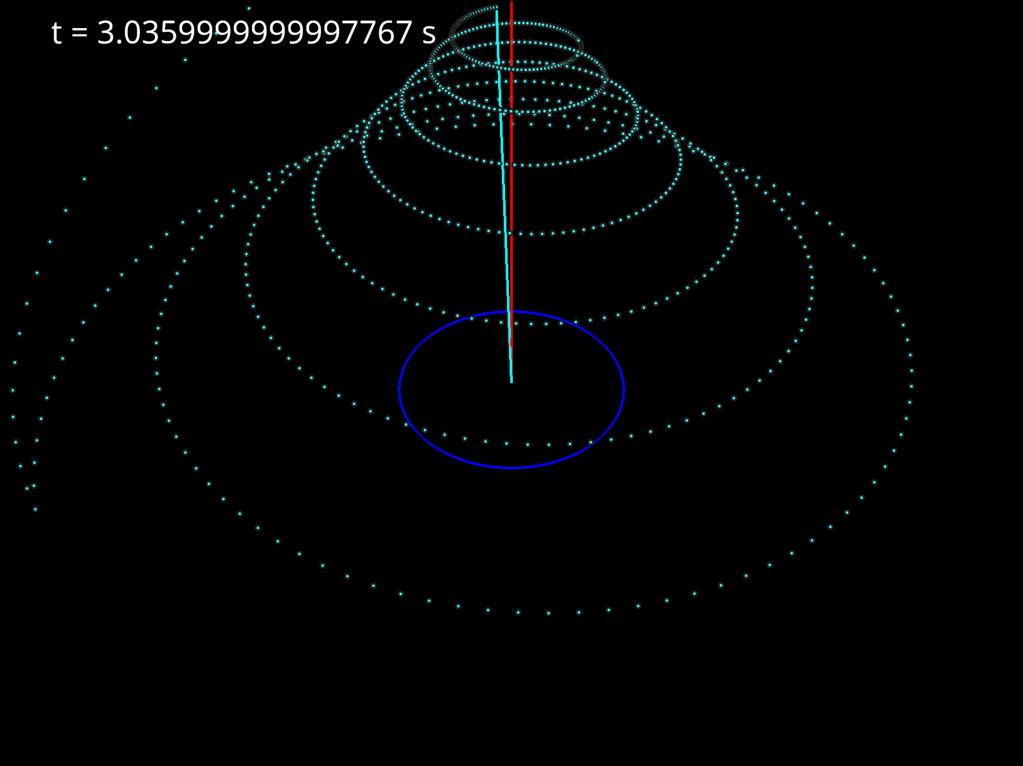
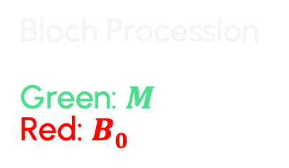
Bloch Procession
Green: $M$
Red: $B0$
Harvard College
CHEM 10
Bellows

Slide 10
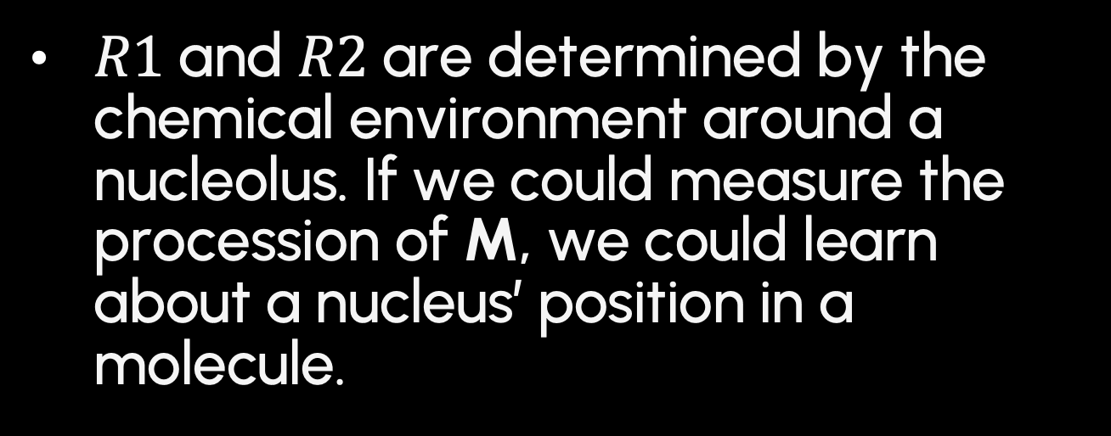
How can we use Bloch Procession to study molecules?
$R1$and $R2$are determined by the chemical environment around a nucleolus. If we could measure the procession of M, we could learn about a nucleus’ position in a molecule.
Harvard College
CHEM 10
Bellows

Slide 11
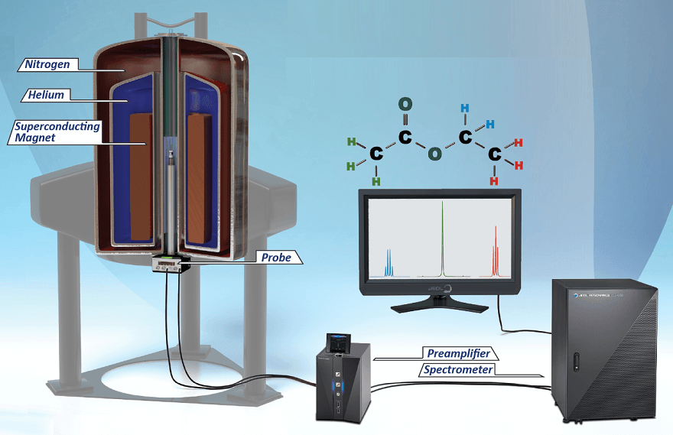

NMR Machines
A sample is placed in a strong B field of around 10T
The effective B field is temporarily changed by applying an RF pulse
The RF pulse knocks down $M$
$M$ processes around $B$ according to the Bloch Equations.
The changing emf is converted into an electric signal
Harvard College
CHEM 10
Bellows

Slide 12
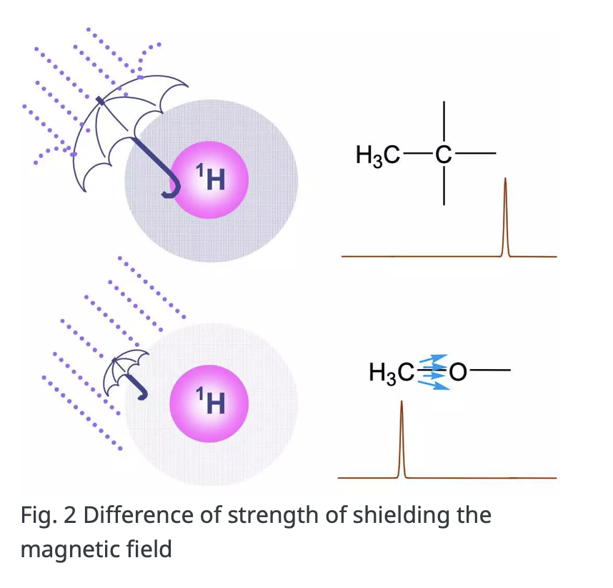
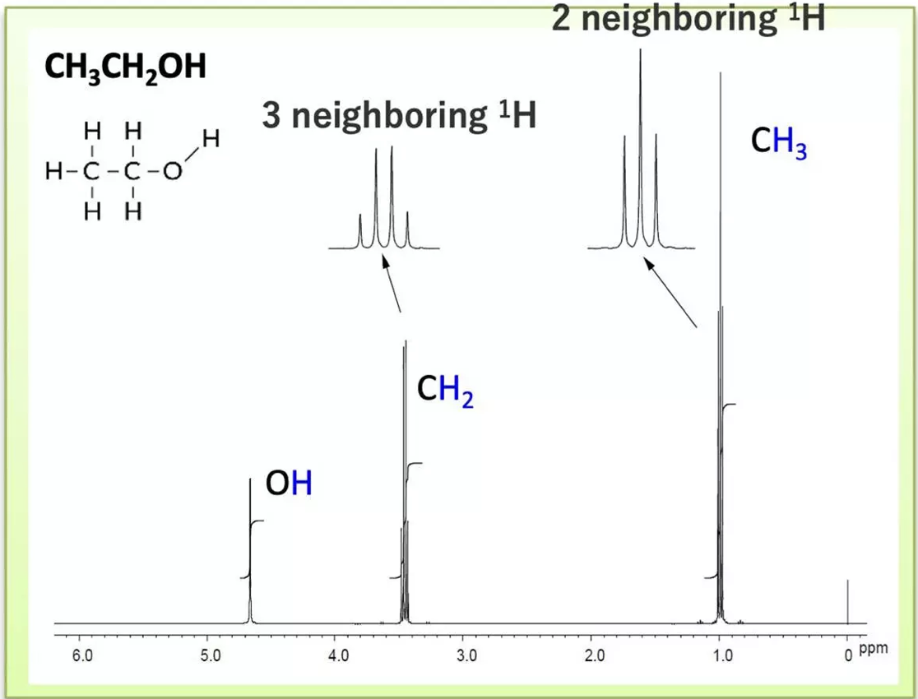
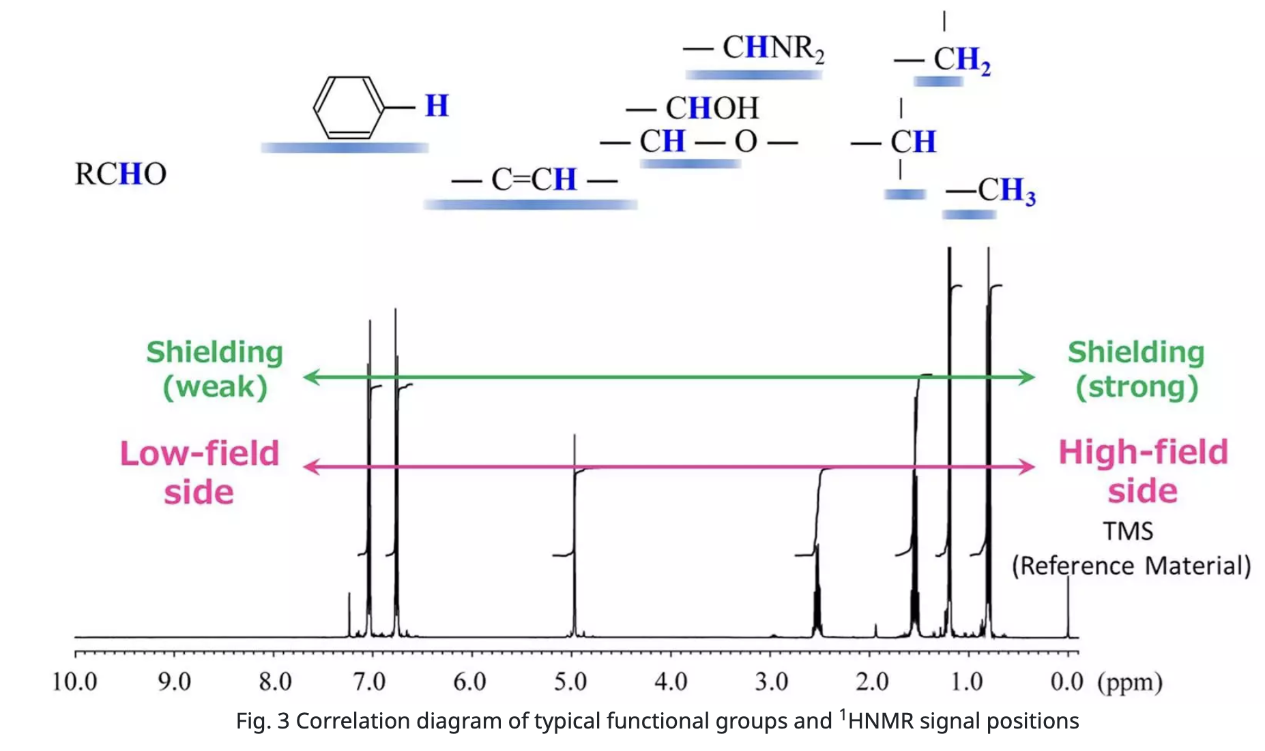
Fast Fourier Transform (FFT) of Free Induction Decay (FID) signal is the NMR spectrum. Its peaks reveal the chemical structure of a given molecule.
Harvard College
CHEM 10
Bellows

Slide 13
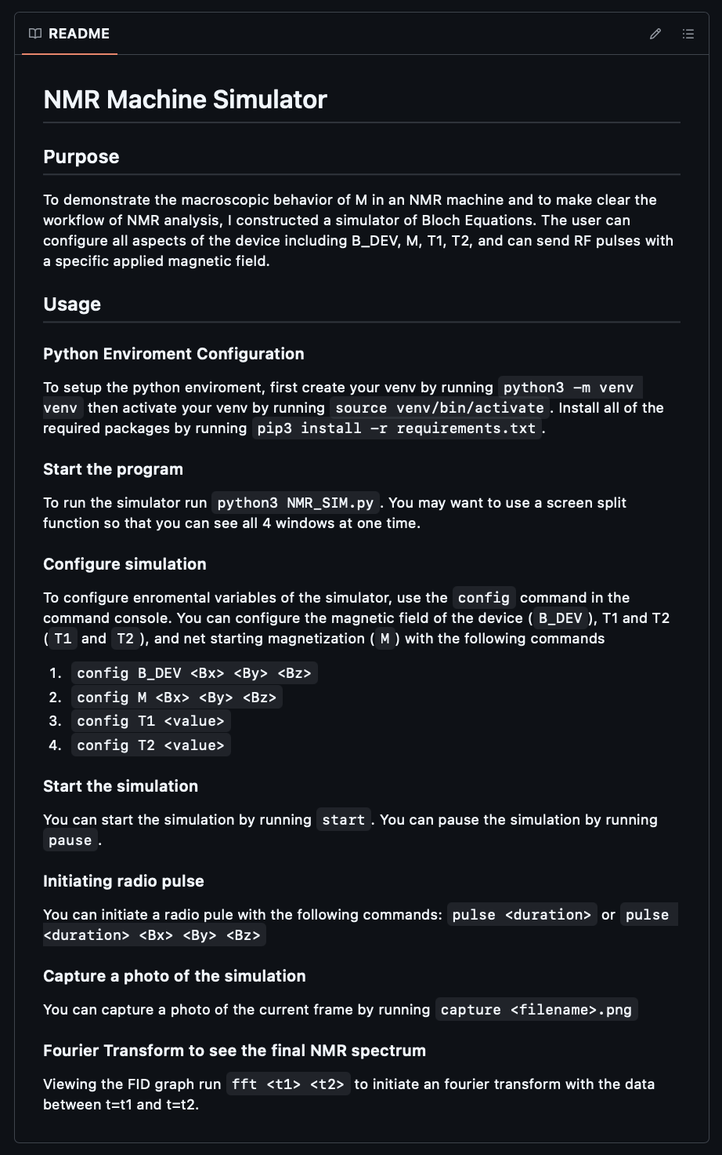

Computational Bloch Equation/NMR Simulator
Demonstrates behavior of processing $M$ in NMR machine
Configure all aspects of the device including $B_DEV, M, T1, T2$
Send RF pulses with specified $B_{effective}$
Source code and detailed instructions at https://github.com/abellows50/CHEM10_NMR_PROJECT
Harvard College
CHEM 10
Bellows

Slide 14
Flow Chart of Code
Create Renderer, Simulator, Console objects and start NMR Simulator and Command Console Thread, Render Thread
Compute Bloch Differential with Bloch Equations based on current object values for M, B_DEV, and sample values (R1, R2, gyromagnetic ratio)
Apply the calculated Bloch Differential to M
Set pulse variable, change B_EFF, create stop_pulse thread to shut off pulse after correct time has elapsed
Render simulator based on current M and B_DEV. Append current end of M vector to list of dots to plot so the path of the vector is clear. Redraw canvas. Runs forever.
Start Radio Pulse
Change value of update simulation variable (Pause/unpause)
Wait for command
Capture Image or print help
Parse command for correct action
Change Environment variables of Simulator
Harvard College
Alert all threads of exit and exit.
Bellows

Slide 15
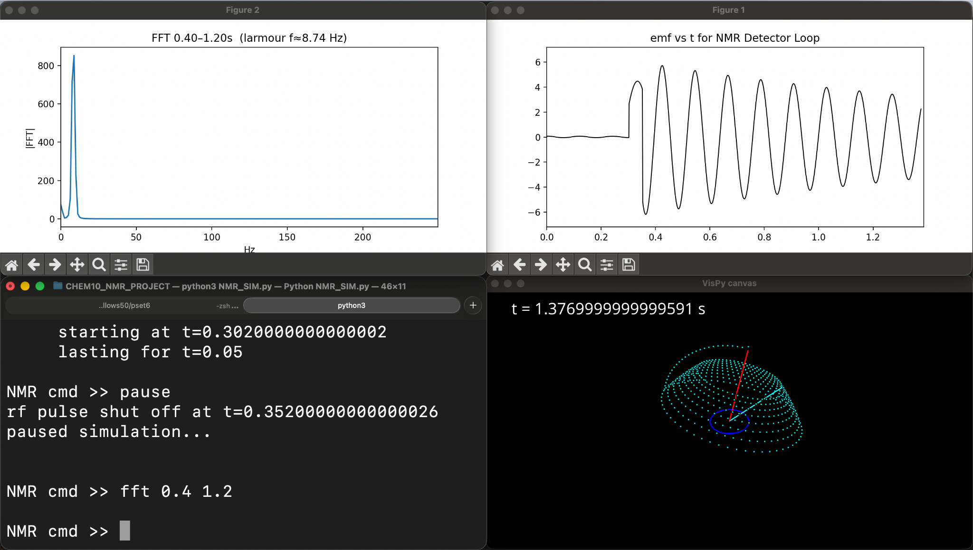

Slide 16
Physical Attempt
Coil: When connected to power supply the coil acts as an electromagnet with magnetic field not aligned with Earth’s magnetic field. When activated, local field increases by 1 mT.
When connected to Detector, rotating magnetic fields are converted to voltage oscillations,
Using Andy Nicol’s Hackaday “Nuclear Magnetic Resonance for Everyone,” I built a basic low field NMR machine.
Audio amplifier: 100x gain
Control box switches whether Detector or Power is connected to coil
Oscilloscope displays signal
Power supply
Harvard College
CHEM 10
Bellows

Slide 17
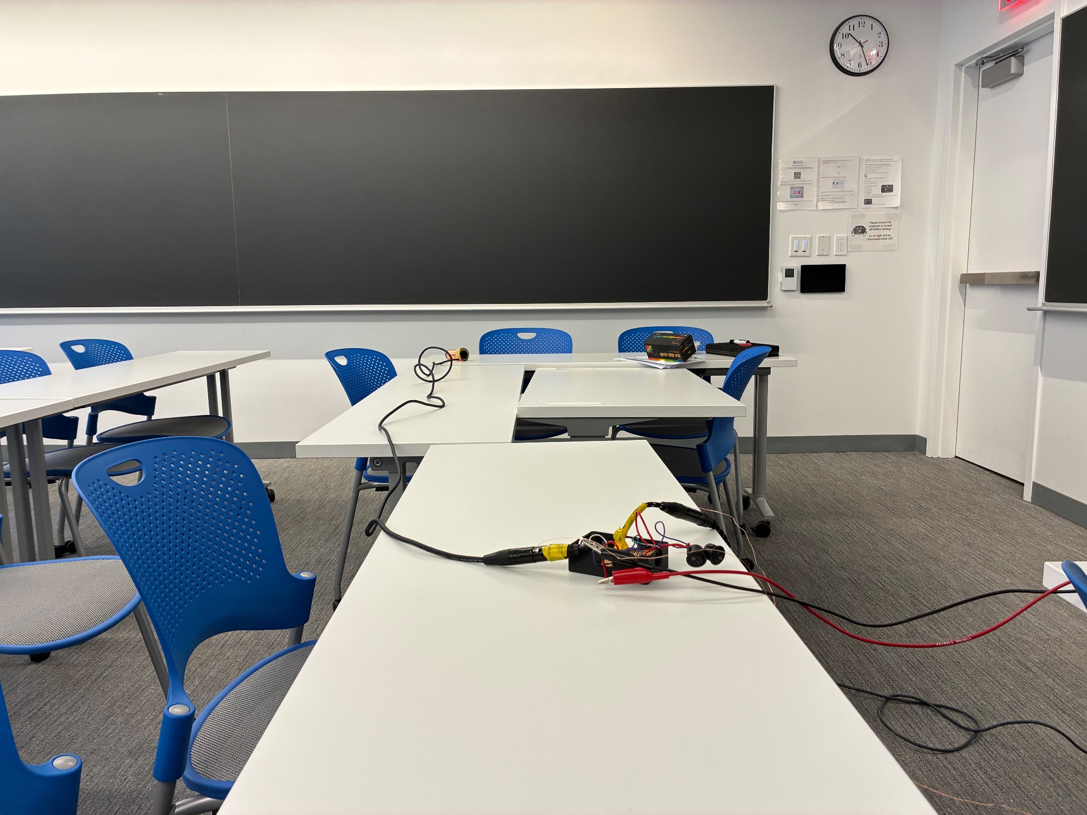
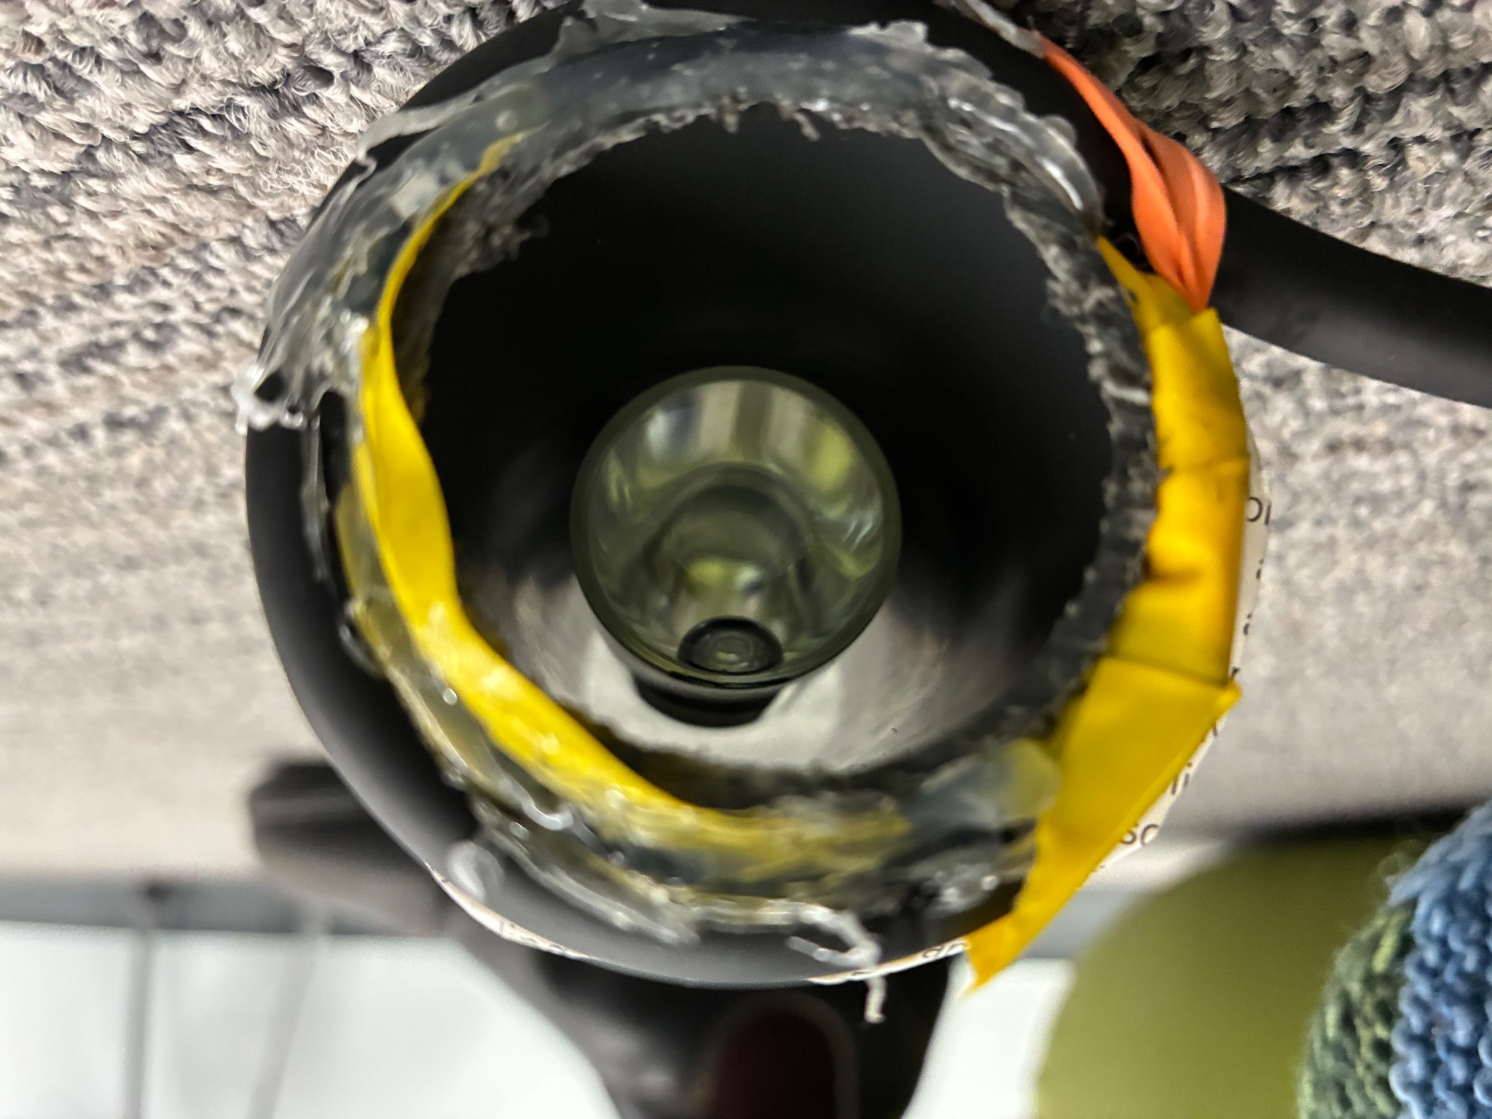
Clockwise from top left: control Box, coil with water sample, amplifier and oscilloscope detector

Slide 18
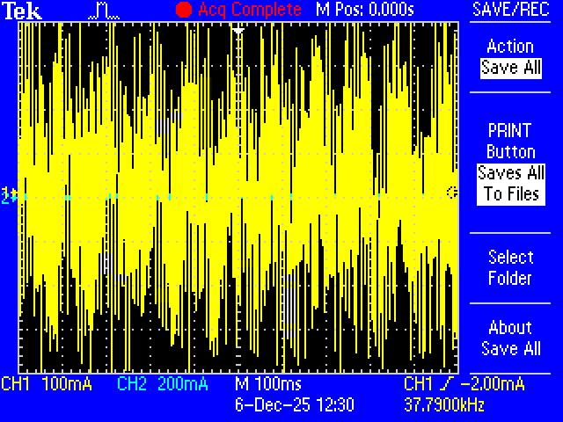
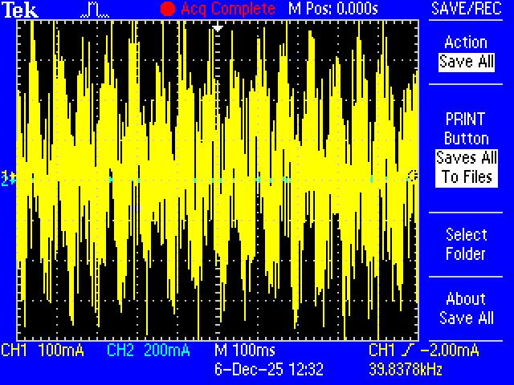
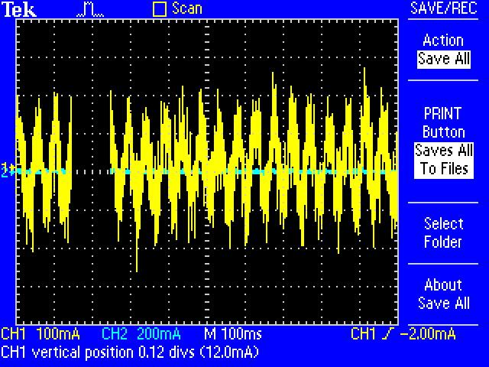
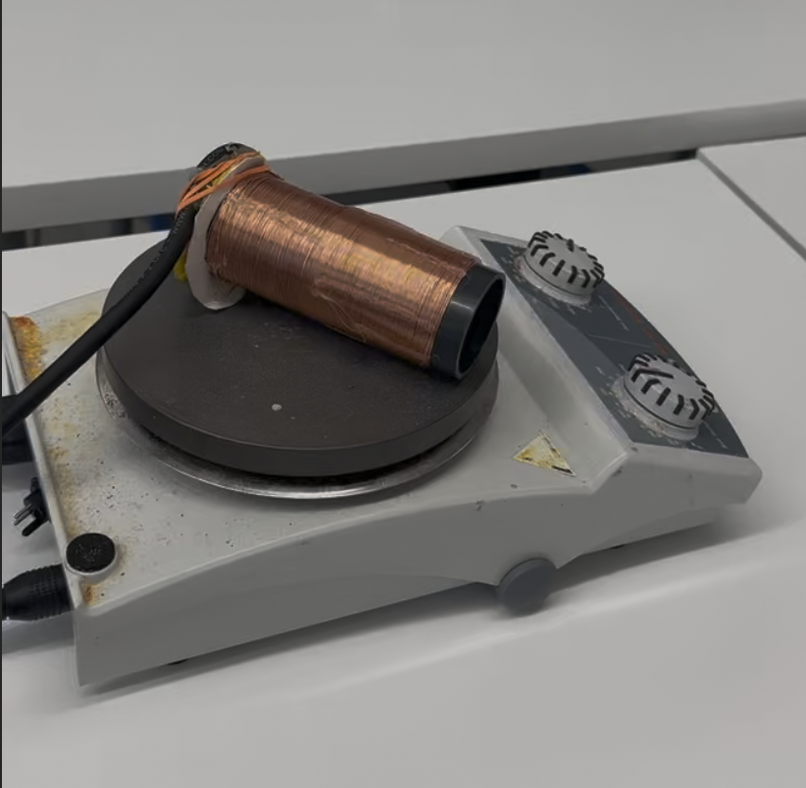
Results with a magnetic stirrer under the coil to create a string rotating magnetic field.
Voltage vs Time graphs for low, medium, and high speeds on the magnetic stirrer.
Clockwise from top left.

Slide 19
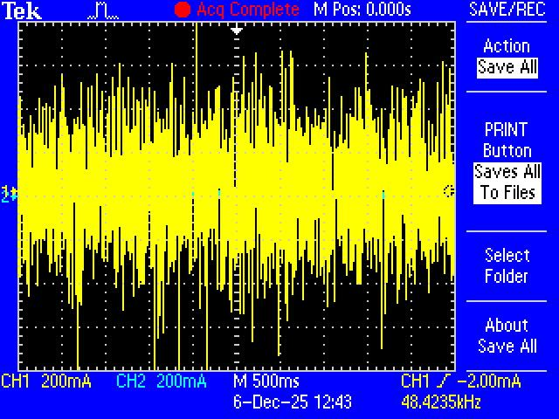
Water sample after a 12 second polarization at 4 Amps and 17 V.
There is too much noise to see the FID signal or get a clear fft.
Sources of noise:
RF noise inducting current in coil
Weak connections
Crossed wires inducing current
Static electricity buildup
Random thermal fluctuations
Faulty equipment
Mitigation
Increase magnetic field strength to increase signal strength
Use faraday cage around apartus
Ground more effectively

Slide 20
Acknowledgements - Khaled: Thank you for spending so many hours advising me in this project and for providing wisdom and support throughout the journey - Andrew: Thank you for helping me clarify my ideas and realize what was possible for this project. - Professor Park and Professor Xu: Thank you for showing how magical and beautiful Quantum Mechanics is and for inspiring all of this work.
Works Cited
JOHN CAVANAGH, WAYNE J. FAIRBROTHER, ARTHUR G. PALMER III, MARK RANCE, & NICHOLAS J. SKELTON. (n.d.). CLASSICAL NMR SPECTROSCOPY. Protein NMR Spectroscopy (Second Edition) Principles and Practice.
Kaseman, D. (2013, October 2). Relaxation. Chemistry LibreTexts. https://chem.libretexts.org/Bookshelves/Physical_and_Theoretical_Chemistry_Textbook_Maps/Supplemental_Modules_(Physical_and_Theoretical_Chemistry)/Spectroscopy/Magnetic_Resonance_Spectroscopies/Nuclear_Magnetic_Resonance/NMR_-_Theory/Relaxation
Liao, Dr. S., Dourmashkin, Dr. P., & Belcher, P. J. W. (n.d.). Faraday’s Law of Induction. MIT Physics 8.02 Electricity and Magnetism. https://web.mit.edu/8.02t/www/802TEAL3D/visualizations/coursenotes/index.htm
Nave. (n.d.-a). Nuclear Magnetic Resonance. Retrieved November 16, 2025, from http://hyperphysics.phy-astr.gsu.edu/hbase/Nuclear/nmr.html#c1
Nave. (n.d.-b). Nuclear Spin Polarization. Retrieved November 16, 2025, from http://hyperphysics.phy-astr.gsu.edu/hbase/Nuclear/spinpol.html#c1
Nave. (n.d.-c). Nuclear Spin Relaxation. Retrieved November 16, 2025, from http://hyperphysics.phy-astr.gsu.edu/hbase/Nuclear/spinrel.html#c1
Newman, M. (n.d.). Bloch sphere | Prefetch. Retrieved December 8, 2025, from https://prefetch.eu/know/concept/bloch-sphere/
NMR Basics for the absolute novice. (n.d.). JOEL Solutions for Innovation. Retrieved December 8, 2025, from https://www.jeolusa.com/RESOURCES/Analytical-Instruments/NMR-Basics
WileyPLUS - NMR spectroscopy and nuclear spin. (n.d.). Wiley Plus. Retrieved December 8, 2025, from https://www.johnwiley.net.au/highered/chemistry2e/wileyplus/basics/nmr/

